Slide 1
First urban civilization of India: Harrapan civilization its town planning.

Slide 2
One of principal feature of this civilization was it town planning as reflected by the remains of Harrappa and Mohenjodaro. The planned selltlements and well hygienic drainage system shows not only their civilised nature but also gives us an evidance that there may have existed some form of government .

Slide 3
Historians are of the view that Harrapans followed grid pattern of town planning which made roads and bylanes so straight that they cut each other at right angles.

Slide 4
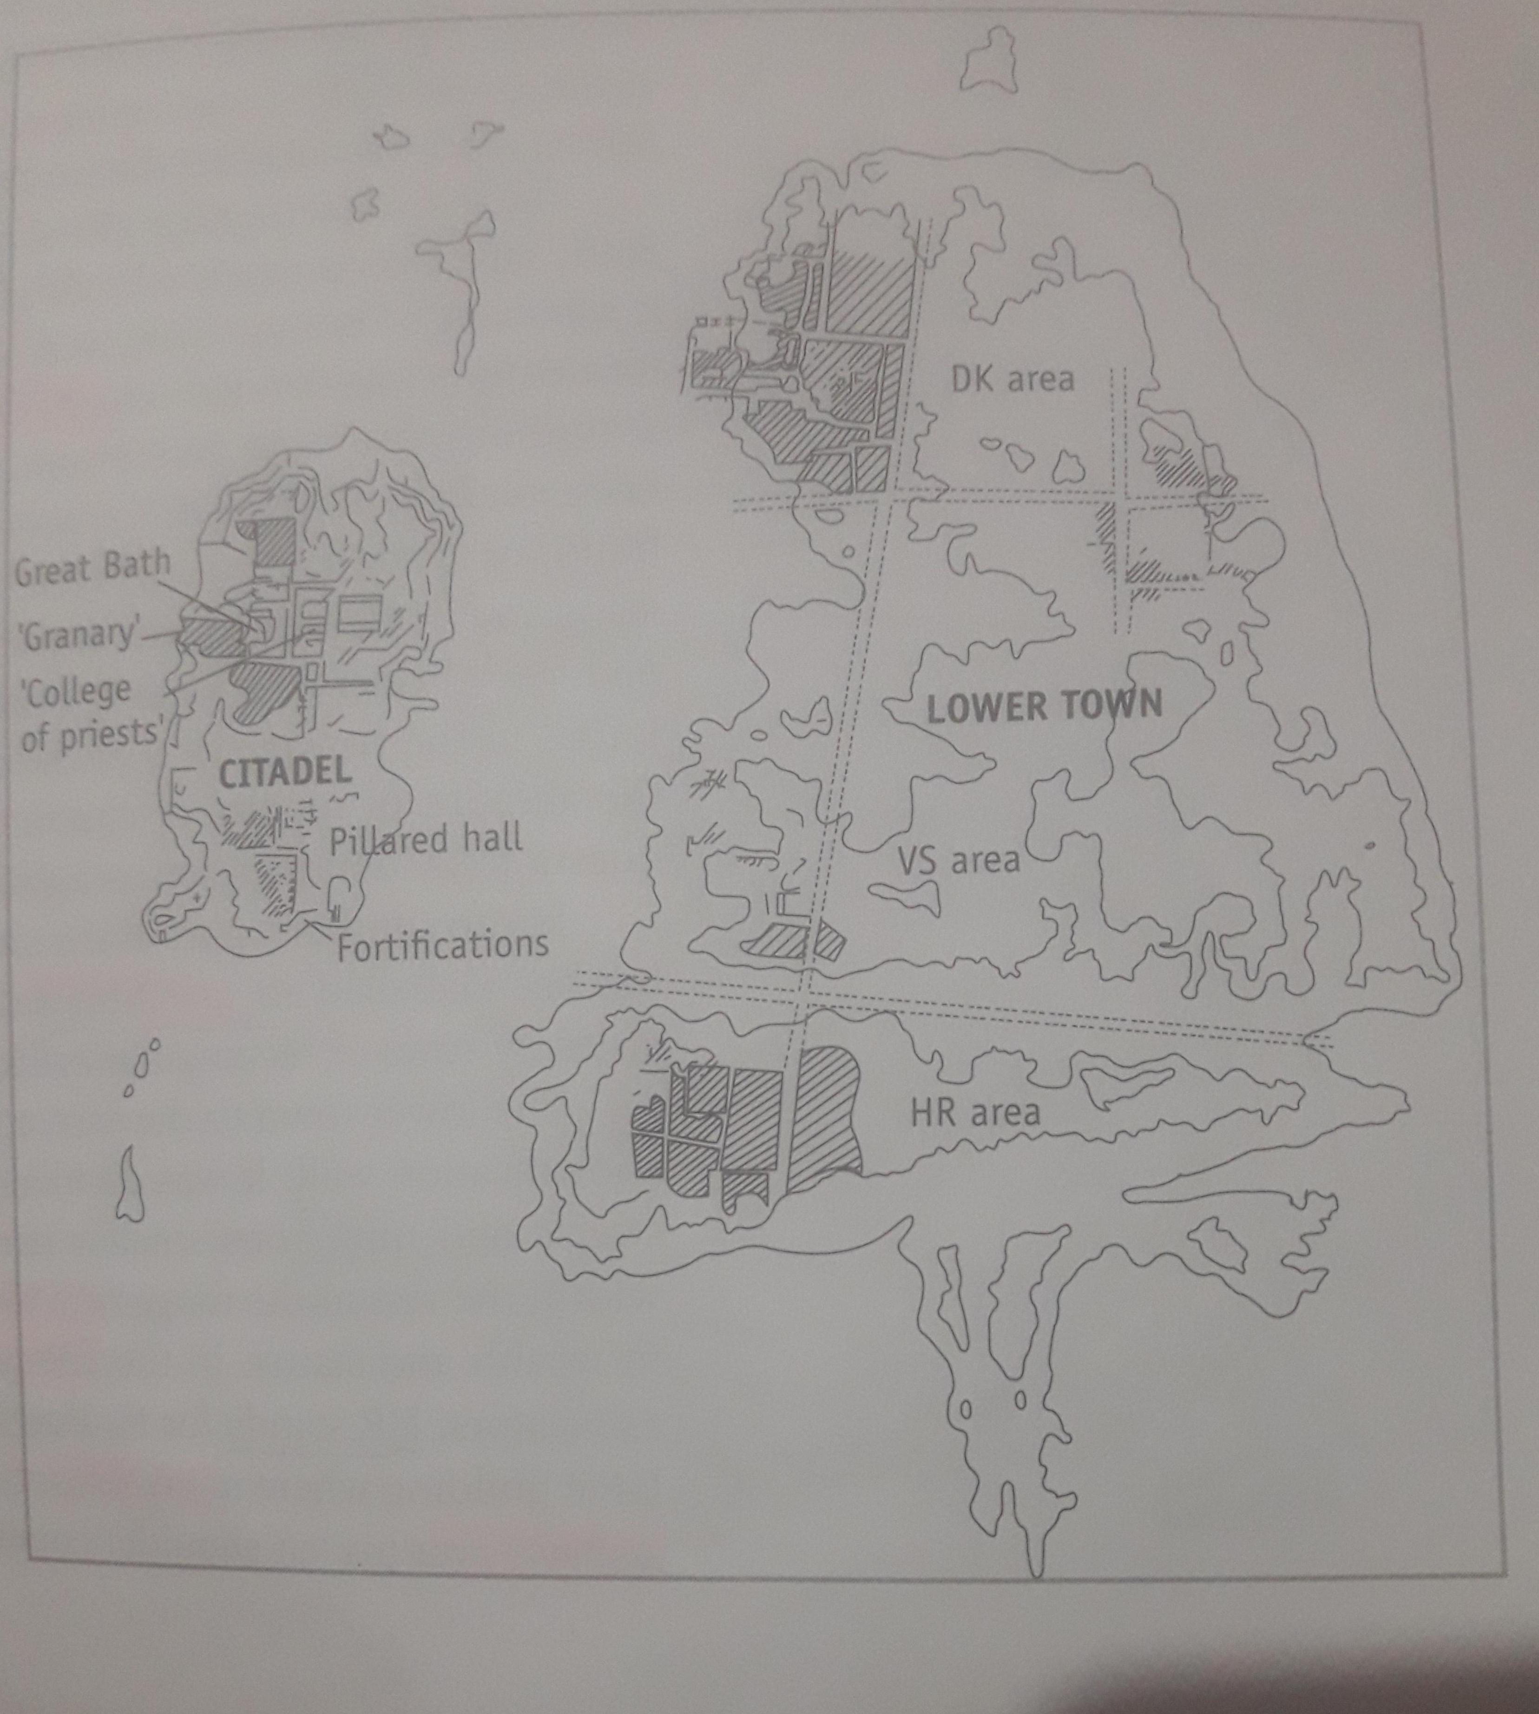
Mohenjodaro town: Different areas of the city

Slide 5
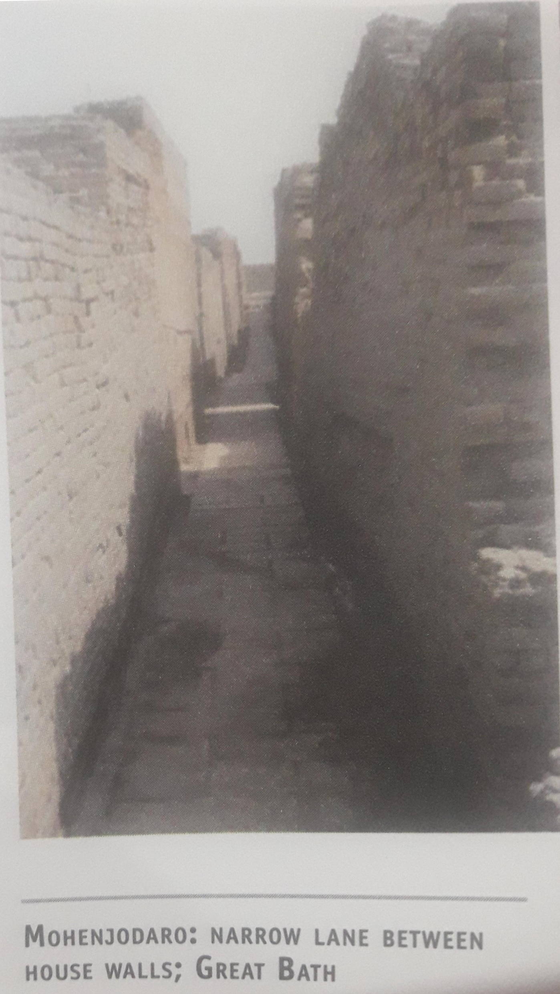
Absolutely straight lane with no dead end in Mohenjodaro

Slide 6
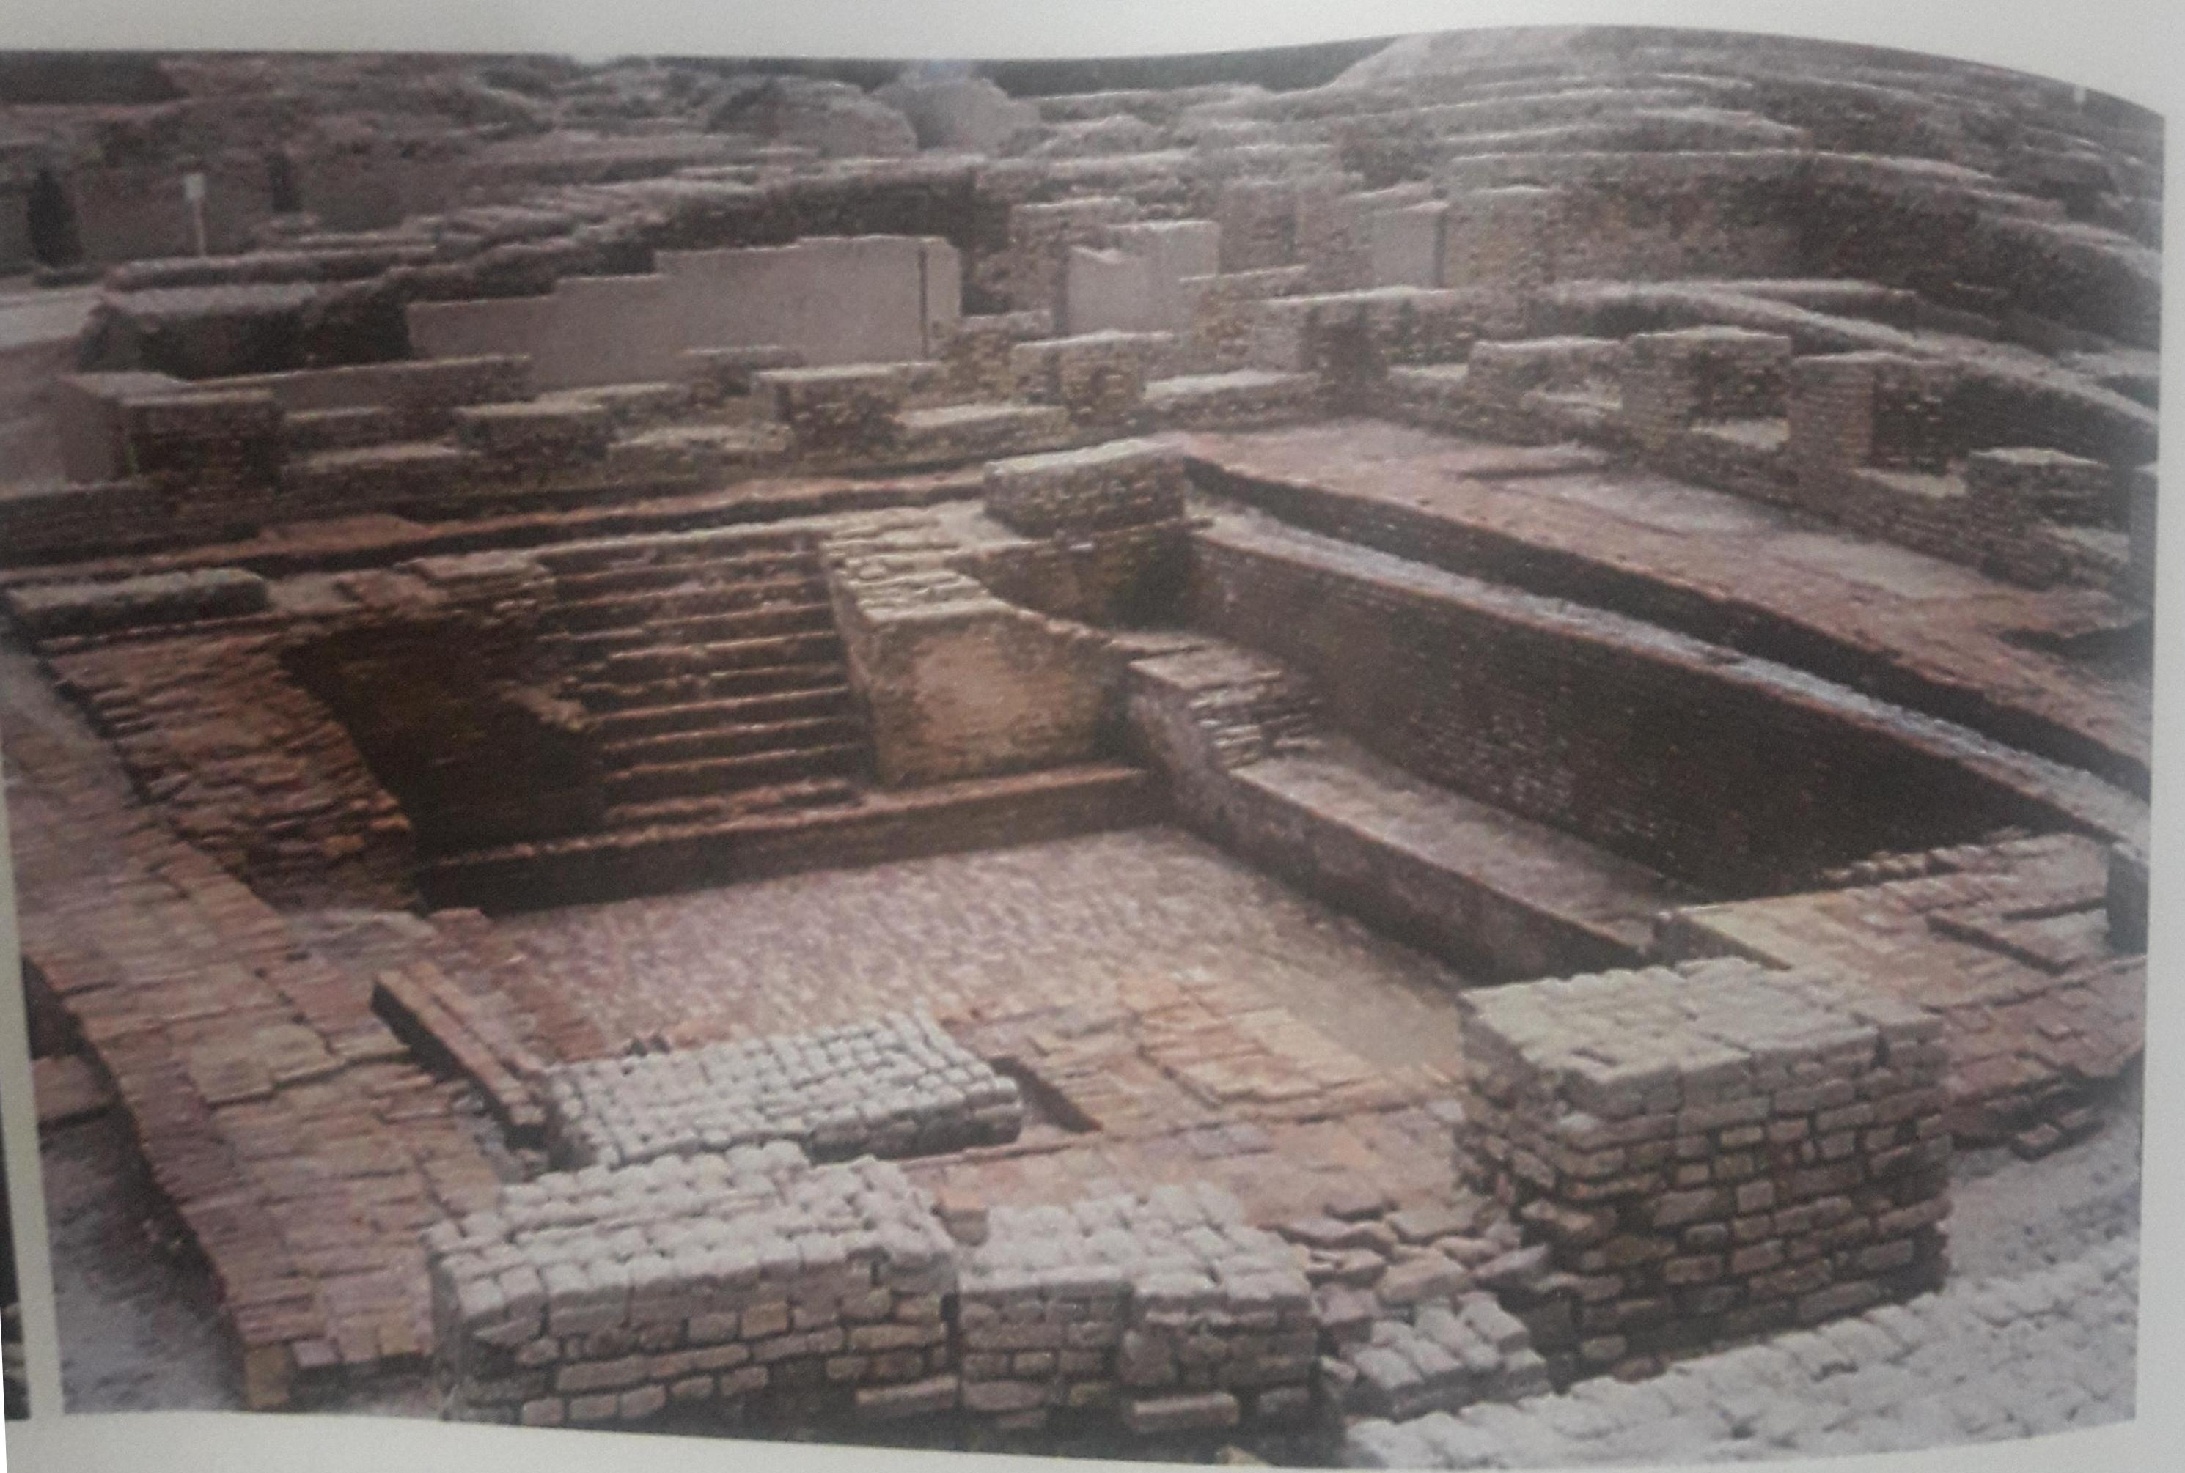
Great bath in the citadel area or upper town of Mohenjodaro

Slide 7
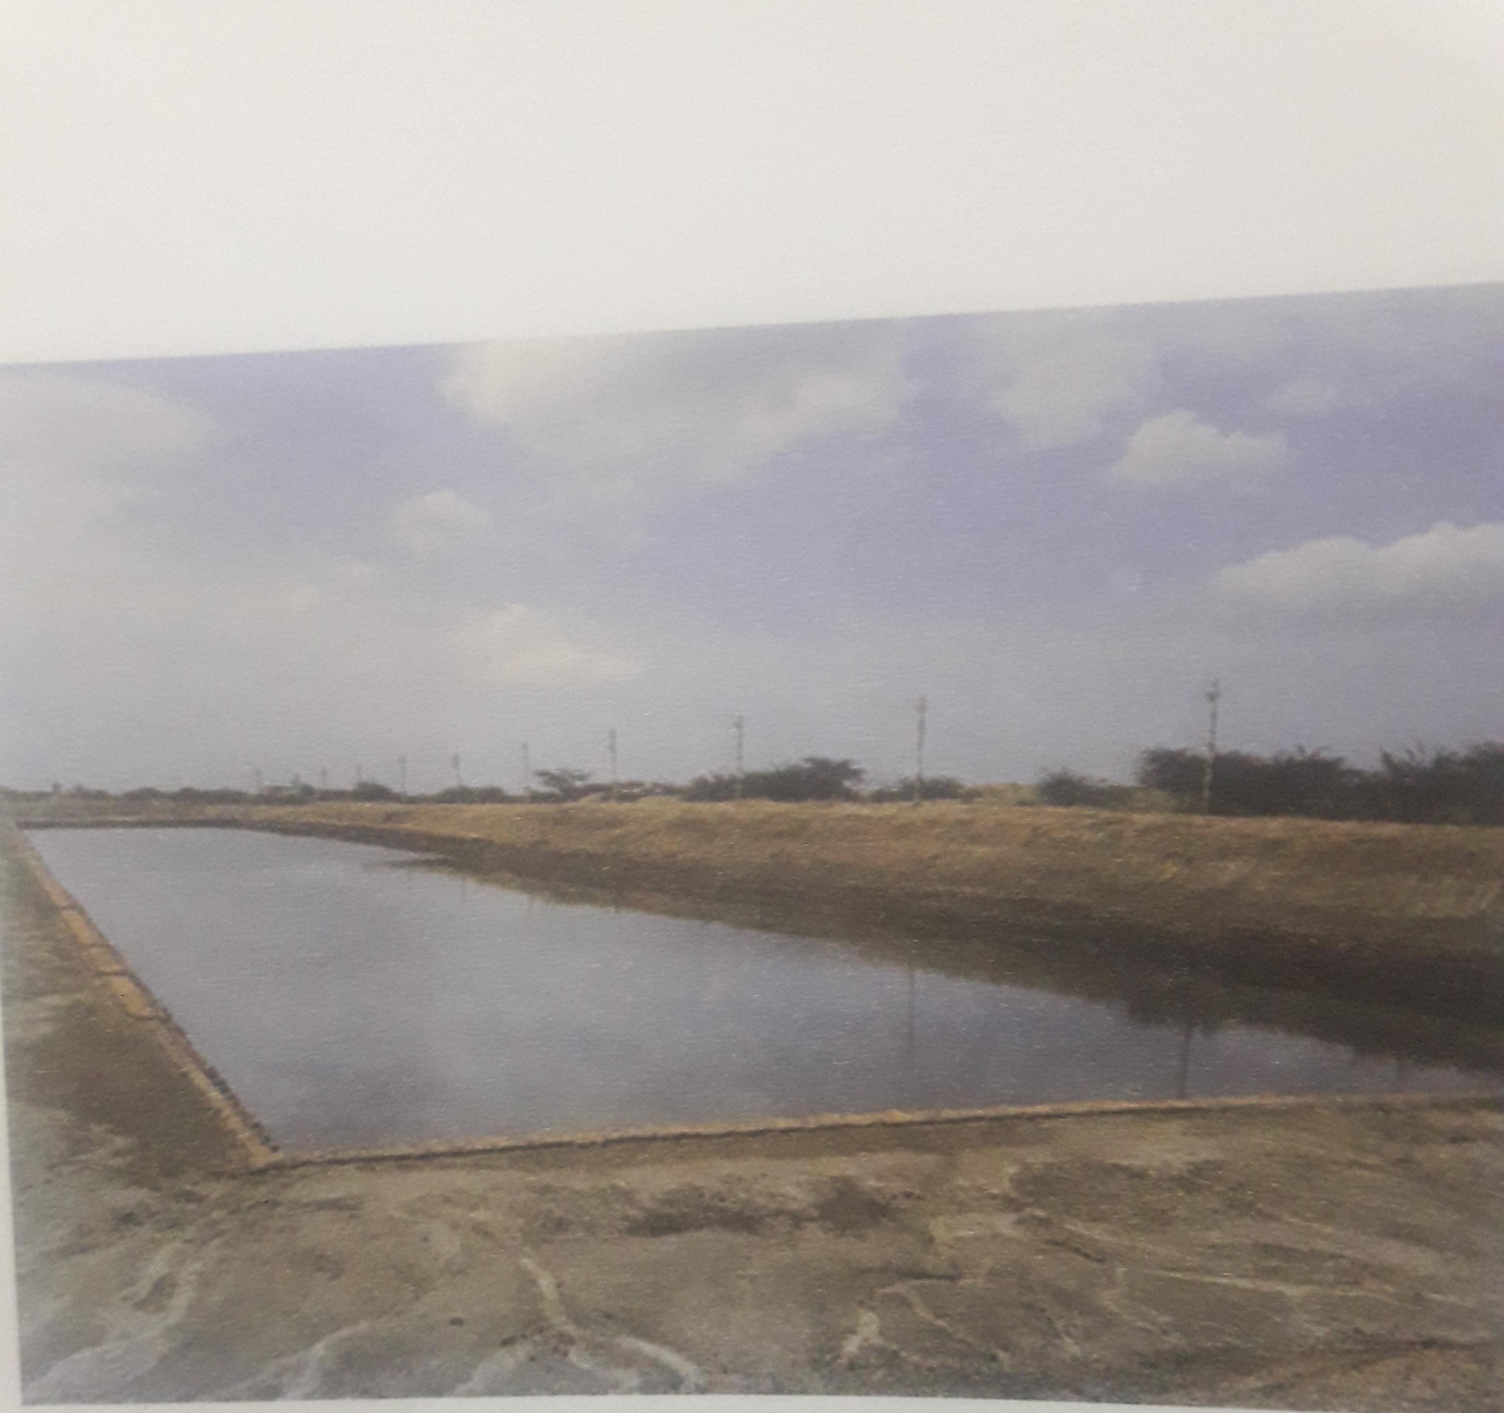
Dockyard at Lothal in Gujrat ...It is one of the important evidence attesting overseas trading contacts of Harrappans.

Slide 8
Conclusion. Harrapan civilization is the first civilization of India which displayed civic sense as for as settlement pattern, Drainage and other aspects are concerned. Praising their drainage system Piggot writes, “ the whole drainage system shows remarkable concern for health and hygiene which is having no parallel in the orient neither in the pre-historic past nor at present day”.

